Slide 1

HDARC Presentation
Antenna Assembly and Test
Dr. Fong DBJ-1 Antenna
Instruction Materials
September 6, 20245

Slide 2
CAUTIONARY
Please know, HDARC assumes no liability for any personal injury to builders who undertake this project.
Any deviation from the suggested construction of the antenna assembly is the consequential responsibility of the builder.
In other words, please understand that we can only help you with what we told you to do.
If you wish to strike out on your own, then good on you, so please enjoy the following assembly and test activity.
2

Slide 3
INTRODUCTION
Welcome to another HDARC build activity.
The following slides will step you through an assembly and test of a Dr. Fong DBJ-1 antenna.
The DBJ-1 is a dual-band VHF/UHF antenna:
  Developed by Dr. Edison Fong, RF professor at the University of California Santa Clara, and
  Offered through sale at his website, at https://www.edsantennas.weebly.com
3

Slide 4
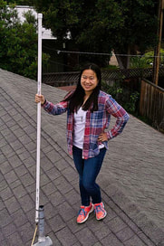

INTRODUCTION
Dr. Fong DBJ-1 Dual-Band Antenna
Dr. Edison Fong
Dr. Fong 2.0
4

Slide 5
INTRODUCTION
HDARC works with Dr. Fong to make these antennas available to our membership at free or a discounted rate to encourage participation in amateur radio activities.
Today’s build and test activity will cover the quick construction of the antenna, and verification of performance.
We anticipate a 1.1:1 or better SWR.
Once completed, take the antenna home, set it up, and enjoy the radio camaraderie.
5

Slide 6
PREREQUISTES
HDARC will provide you with the internal antenna unit:
  You will place the antenna in its PVC housing,
  Verify its SWR with an antenna analyzer, and
  Test against our HDARC repeater.
We will provide the PVC housing and caps.
You will need to provide an HT radio unit and the RG-8X coax cable and adapters for your home installation.
If not, no sweat, we will have these items available for the assembly and testing.
6

Slide 7
PREREQUISTES
Once you get home:
  You just need to mount the antenna in its PVC housing, so it has LOS with Sandia Peak.
  You will need a tripod or some roof/porch assembly point to attach the antenna,
  RG-8X coax cable to connect to your HT or other radio set (See Next Page).
  An SO-259 to PL-259 adapter cable (for HT) or other adapters per your home set-up.
  Some radiator or U-clamps to fasten the antenna in an upright position, similar to what you will see at the build session.
7

Slide 8
Coax Cable Connections
For Baofeng Hand-Held Radios:
  Remove the Rubber Ducky Antenna.
  The exposed connector is either an SMA male or female. (See next page.)
  Attach an SMA to SO-239 Female/Male adapter cable to your hand-held radio (HT).
  Connect an appropriate length of RG-8X coax cable with male connectors between your antenna and the HT adapter cable.
  You may wish to insert an SWR in-line meter or antenna analyzer between the RG-8X and HT adapter cable.
8

Slide 9
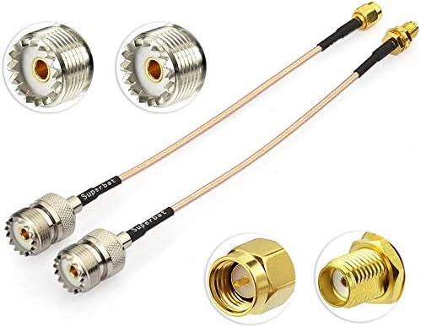
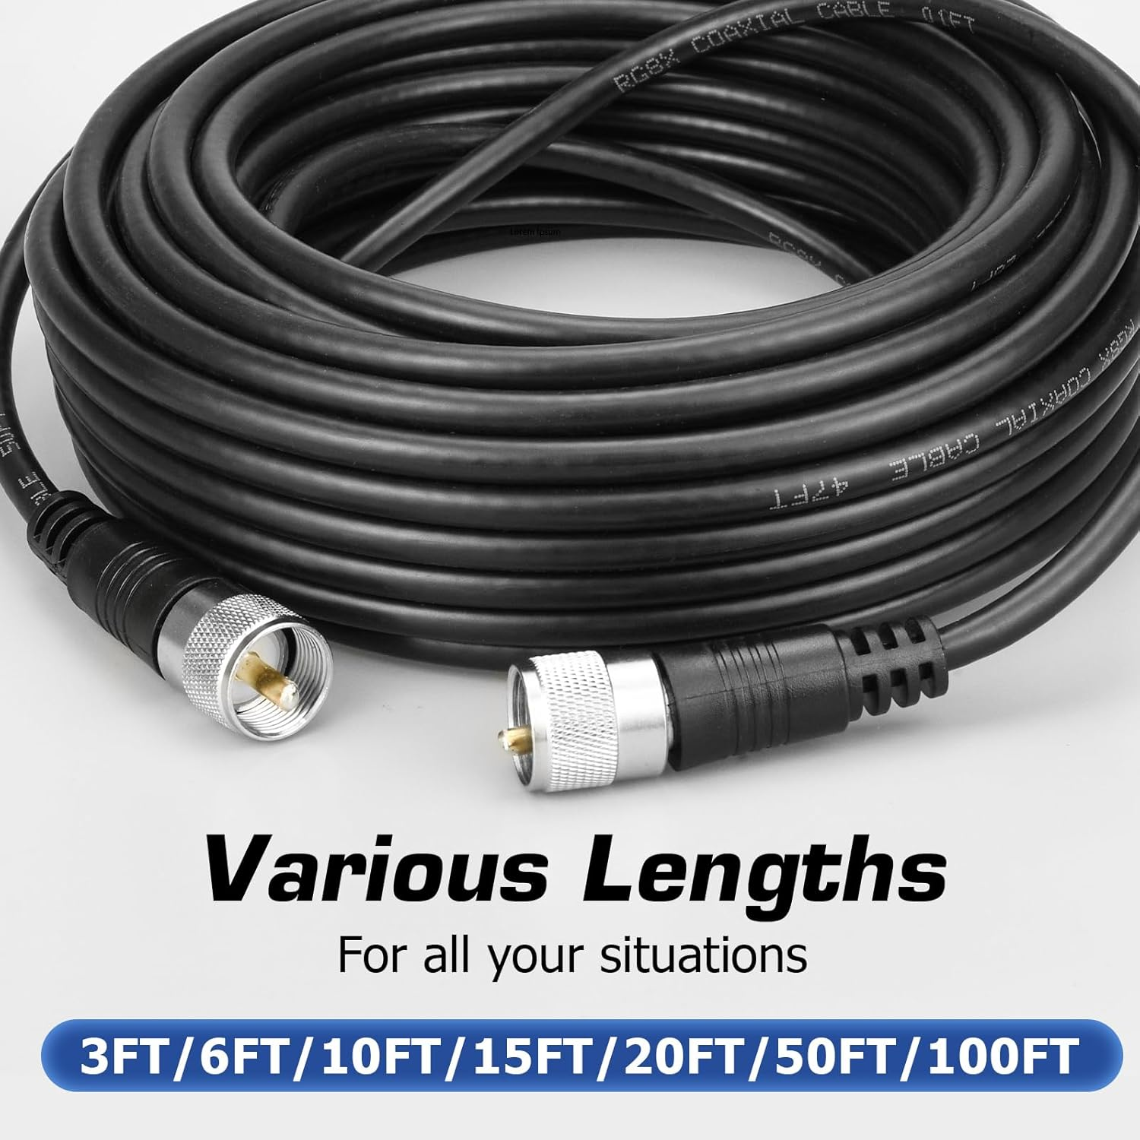
Coax Cable Connections
SMA Male
SO-239 Female
SMA Female
Amazon Link: https://www.amazon/dp/BOBBNN4RV1?smid=A1TE63QTMAEOQO&ref_=chk_type_imgToDp&th=1
9

Slide 10
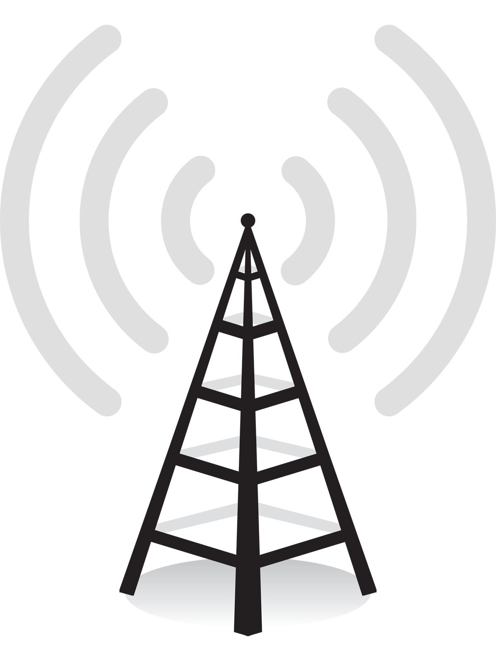
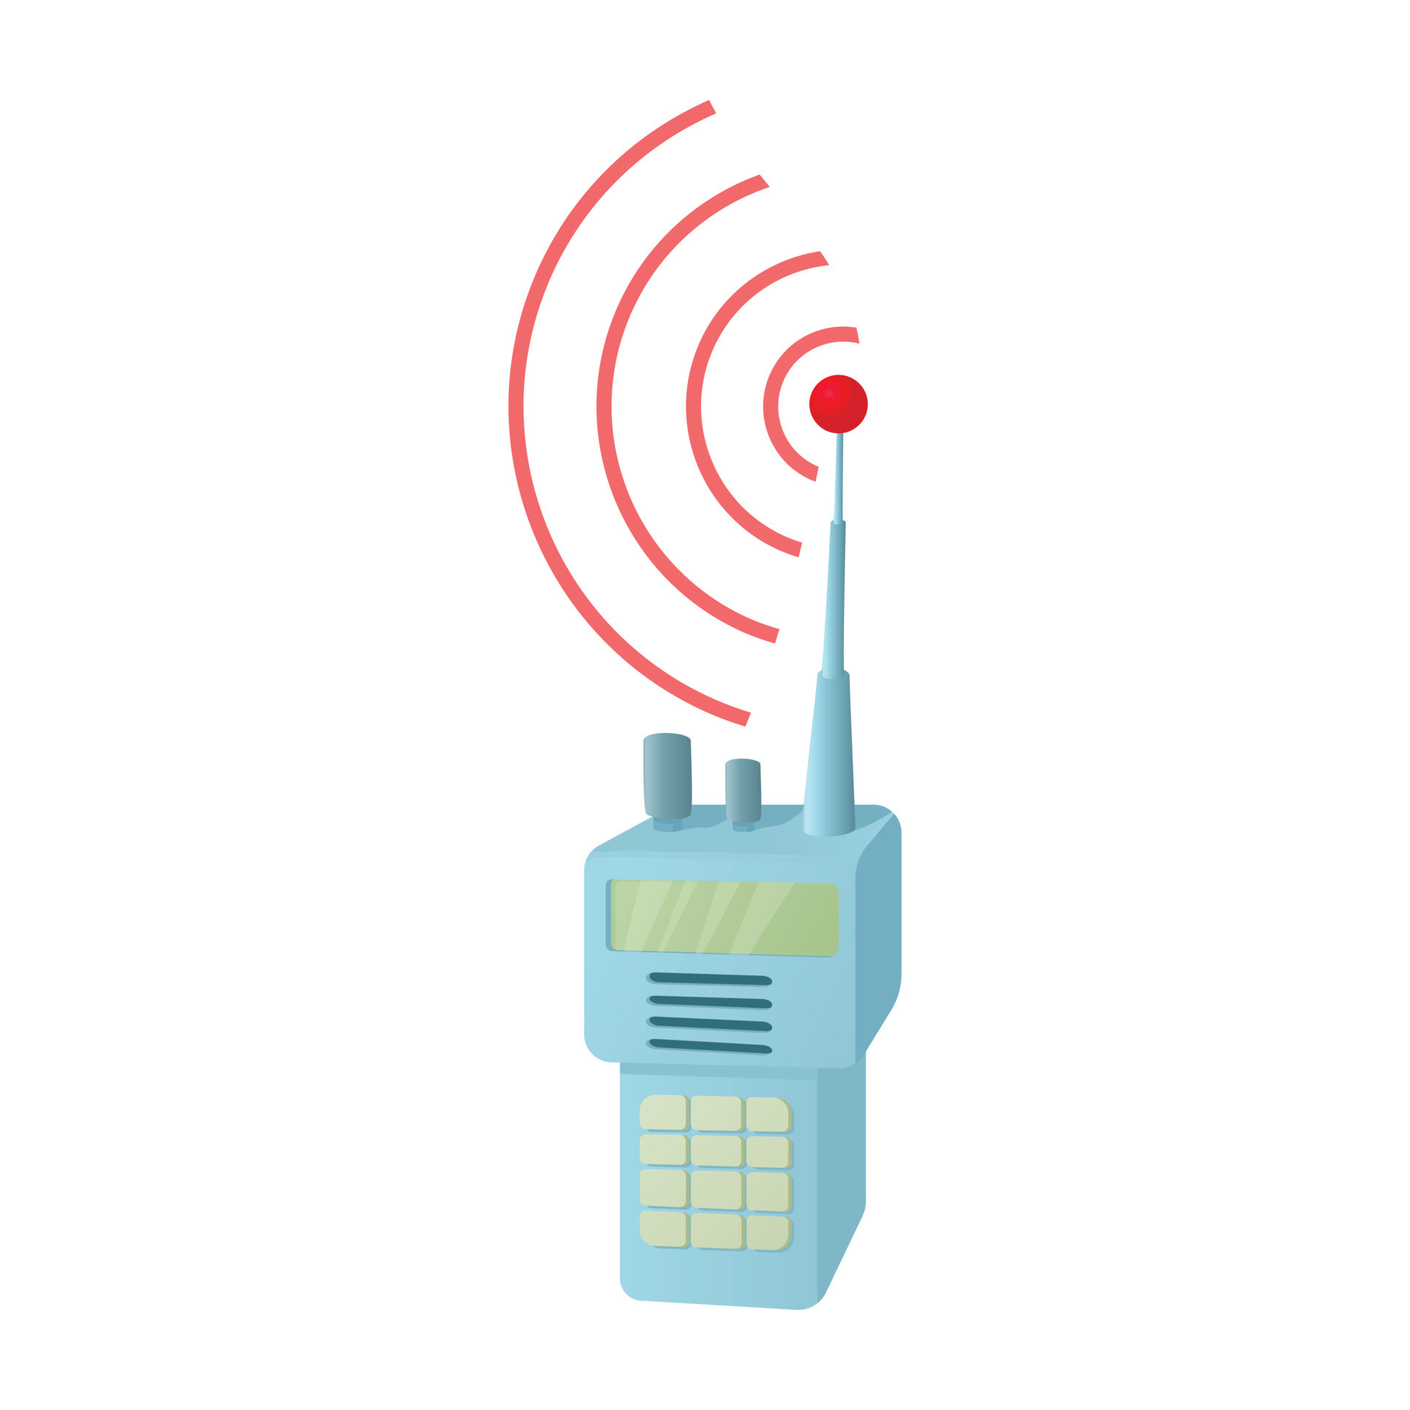
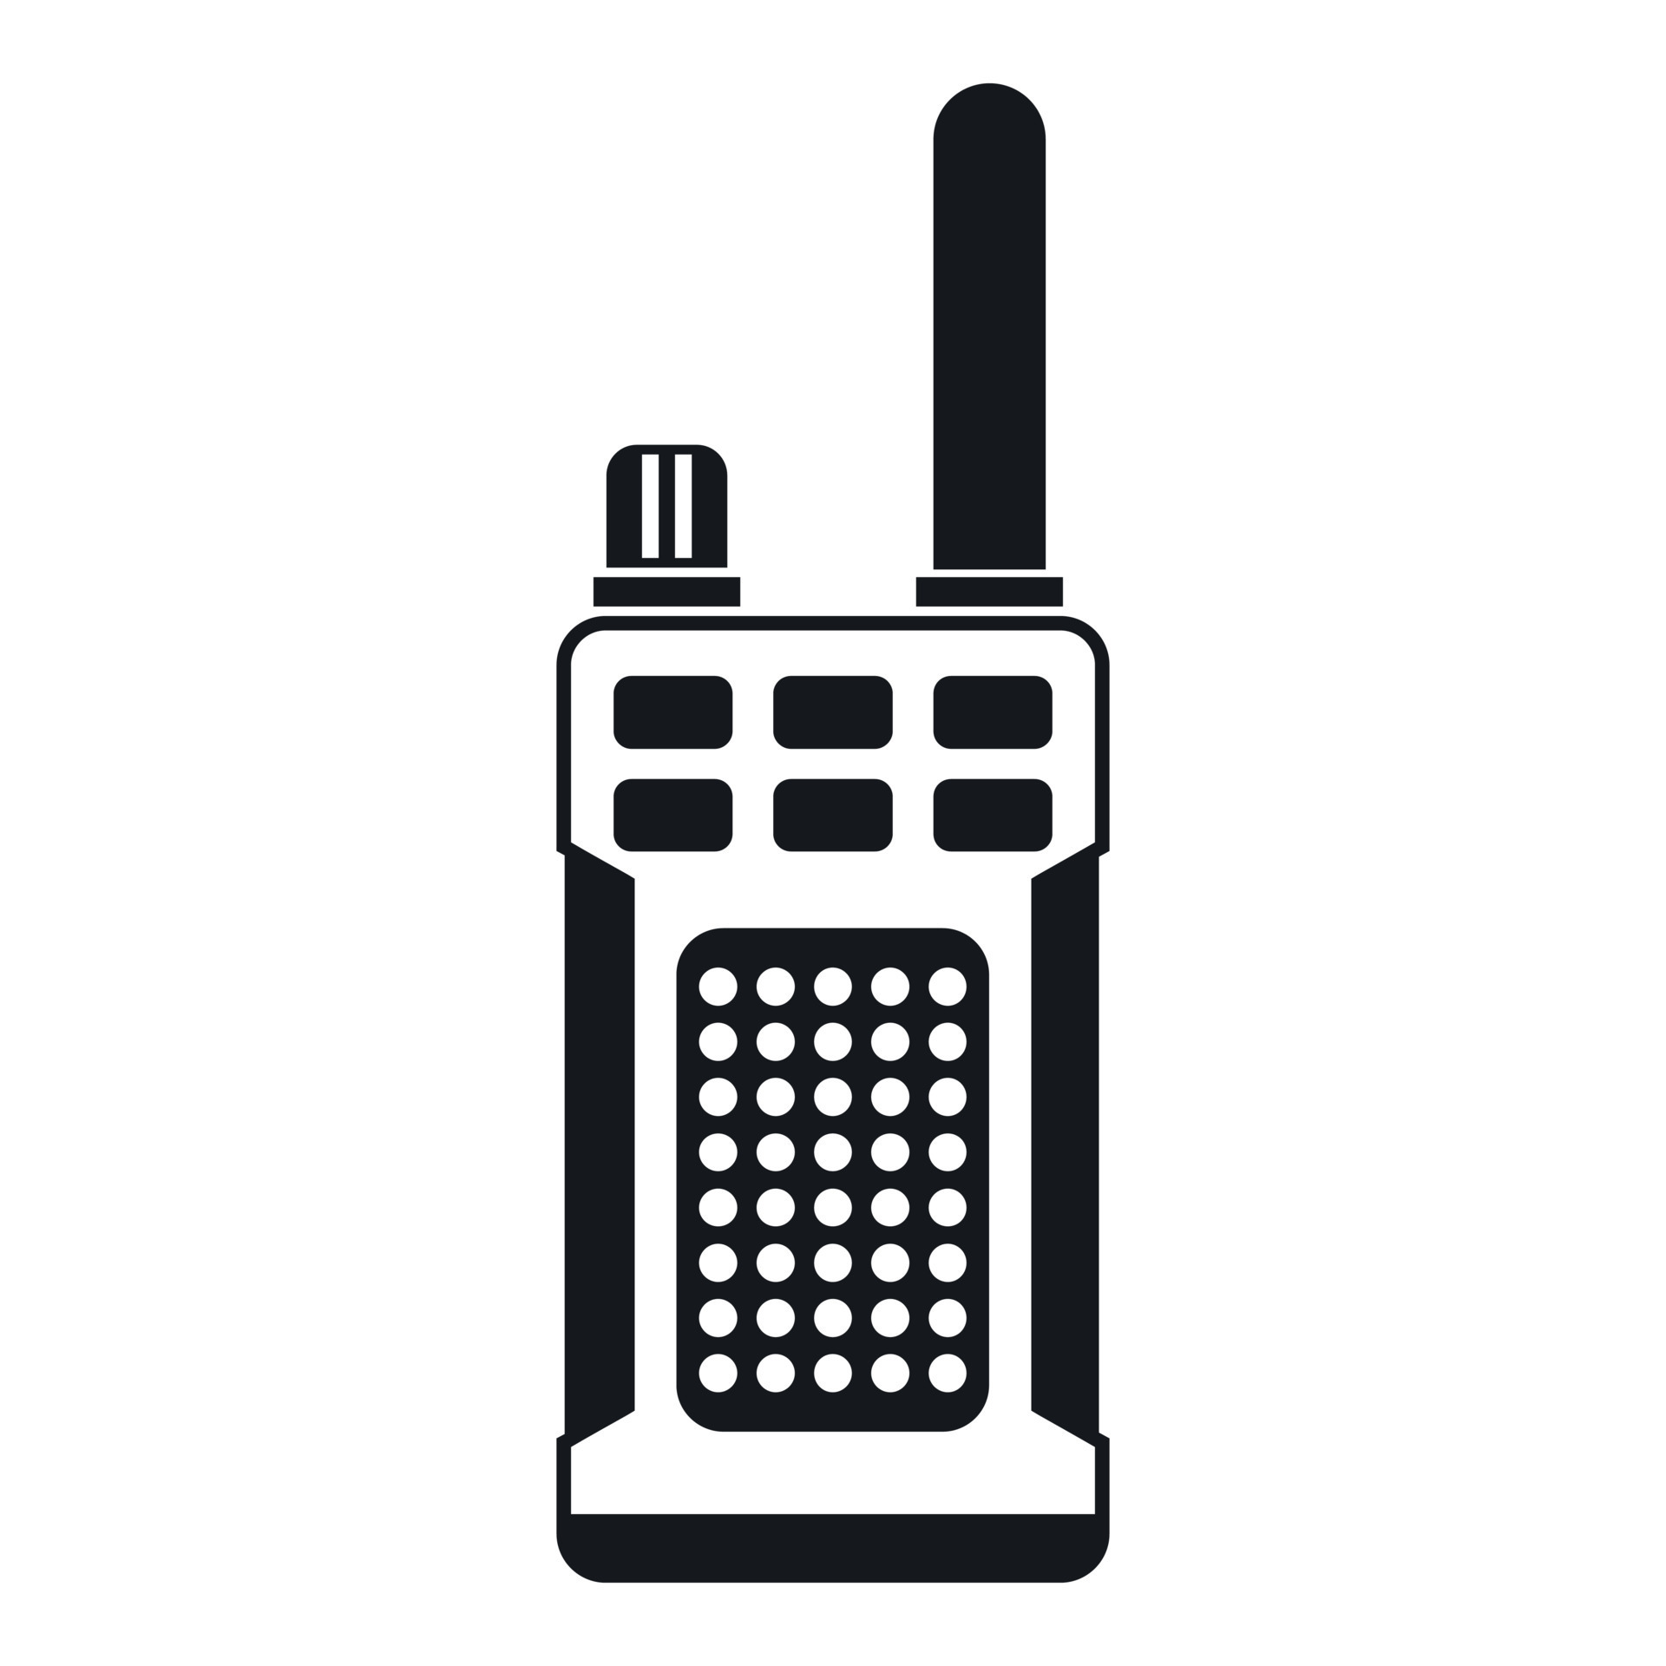
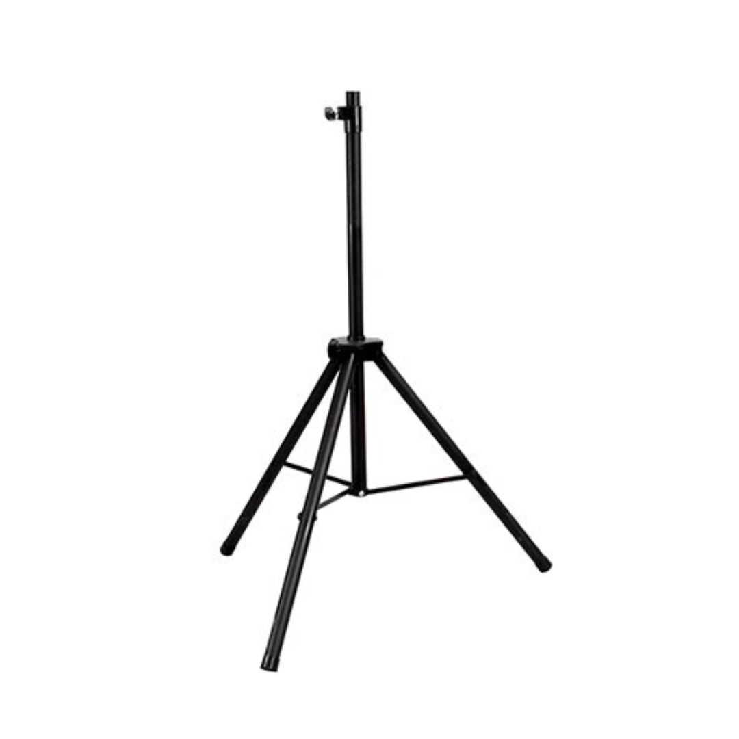
Conceptual Working Antenna
Dr. Fong
DBJ-1
RG-8X
Coax
Adapter
Repeater
Remote
Station
Tripod or Other Mount
Hand Held/
VHF-UHF Radio
Home Station
10

Slide 11
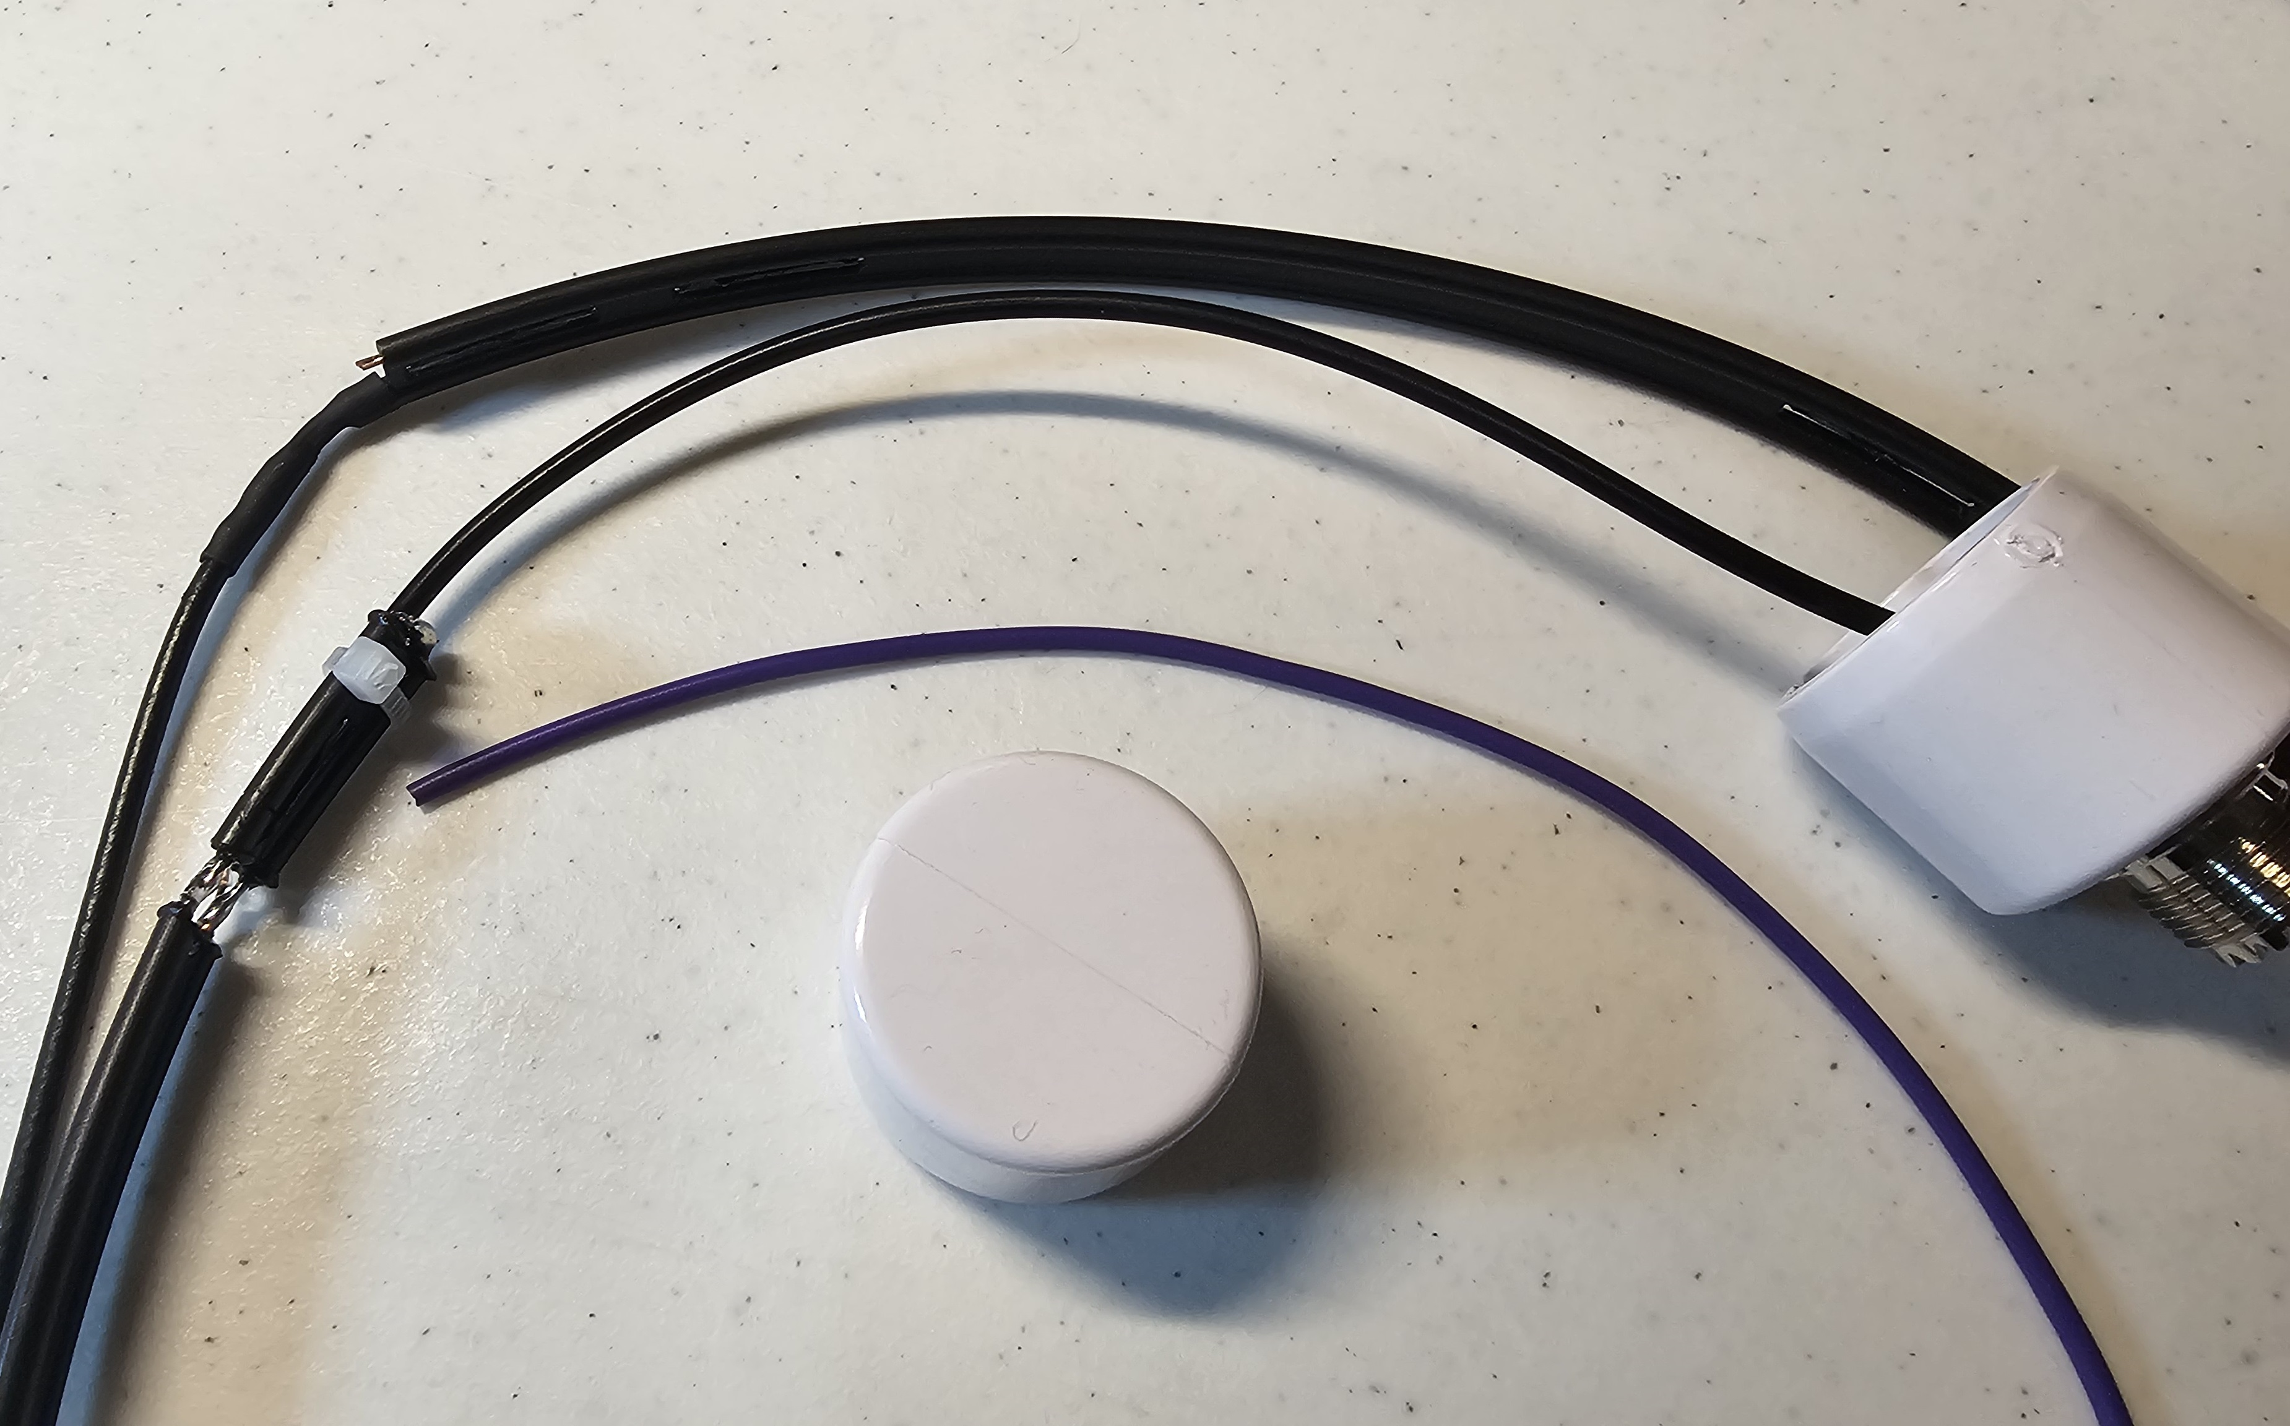
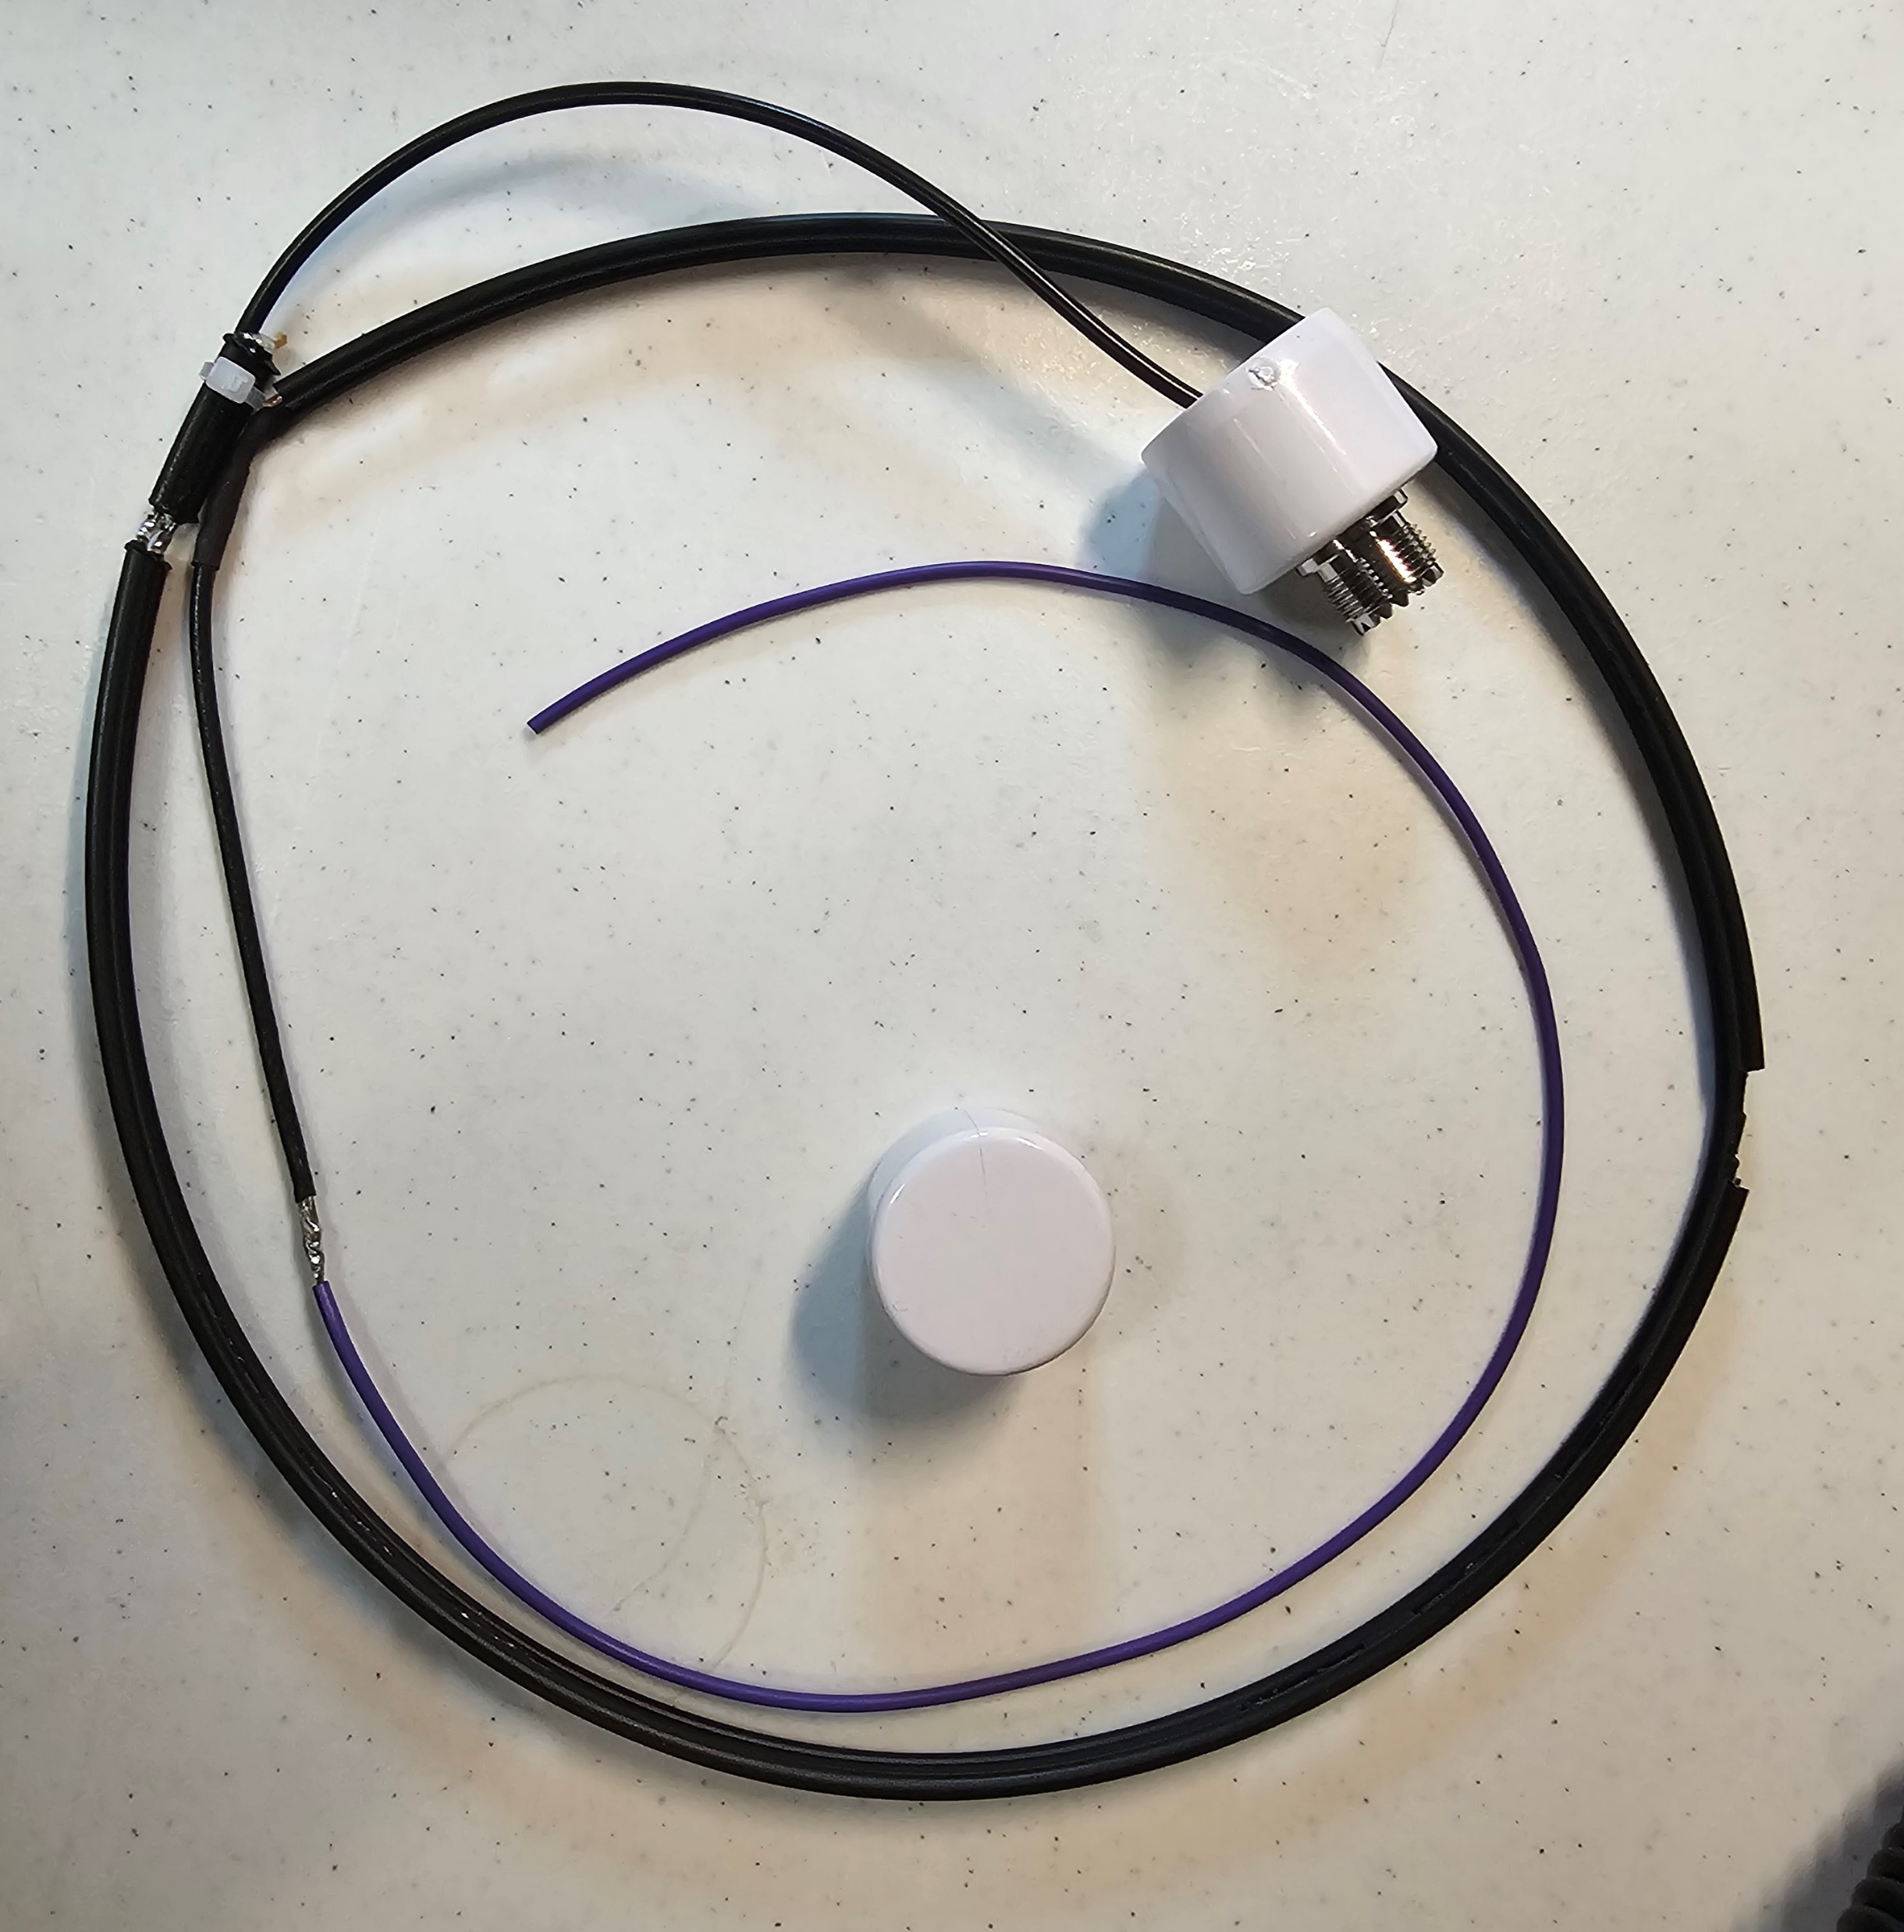
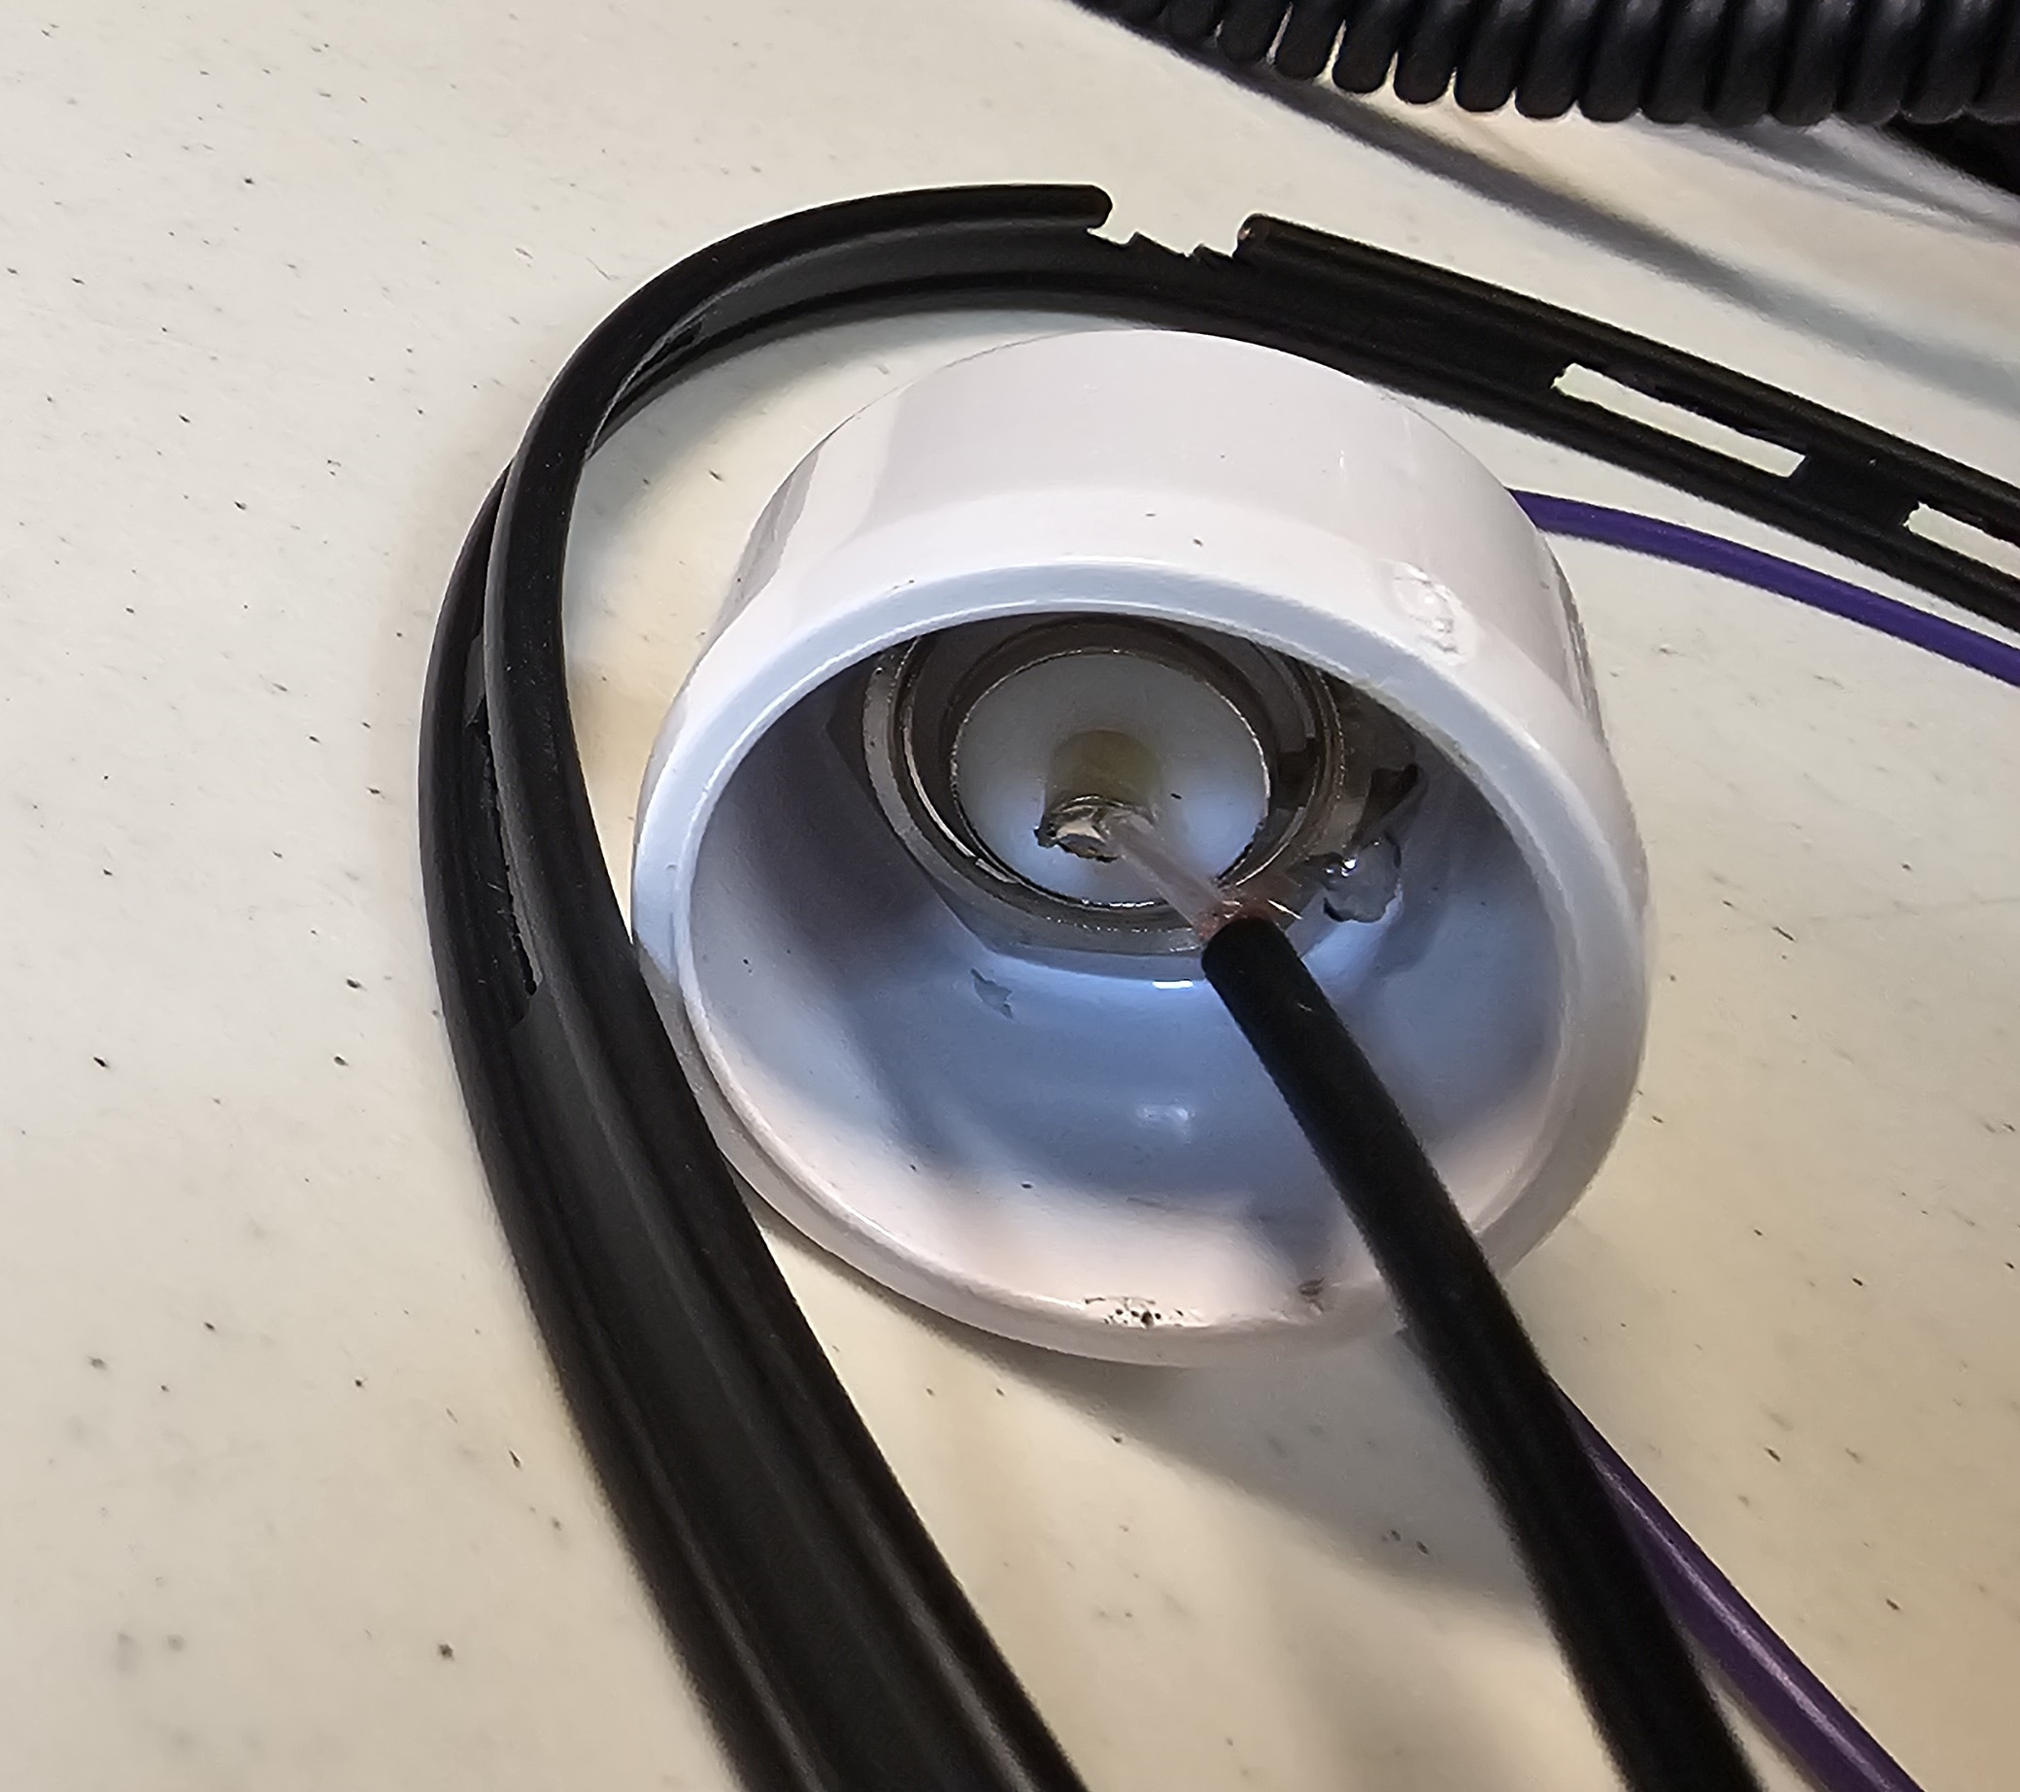
THE BUILD PROCESS
Open the envelop, please.
Bottom
Top
Bottom 6 Inches
The Naked
DBJ-1 Antenna with Top Cap
Bottom Cap
11

Slide 12
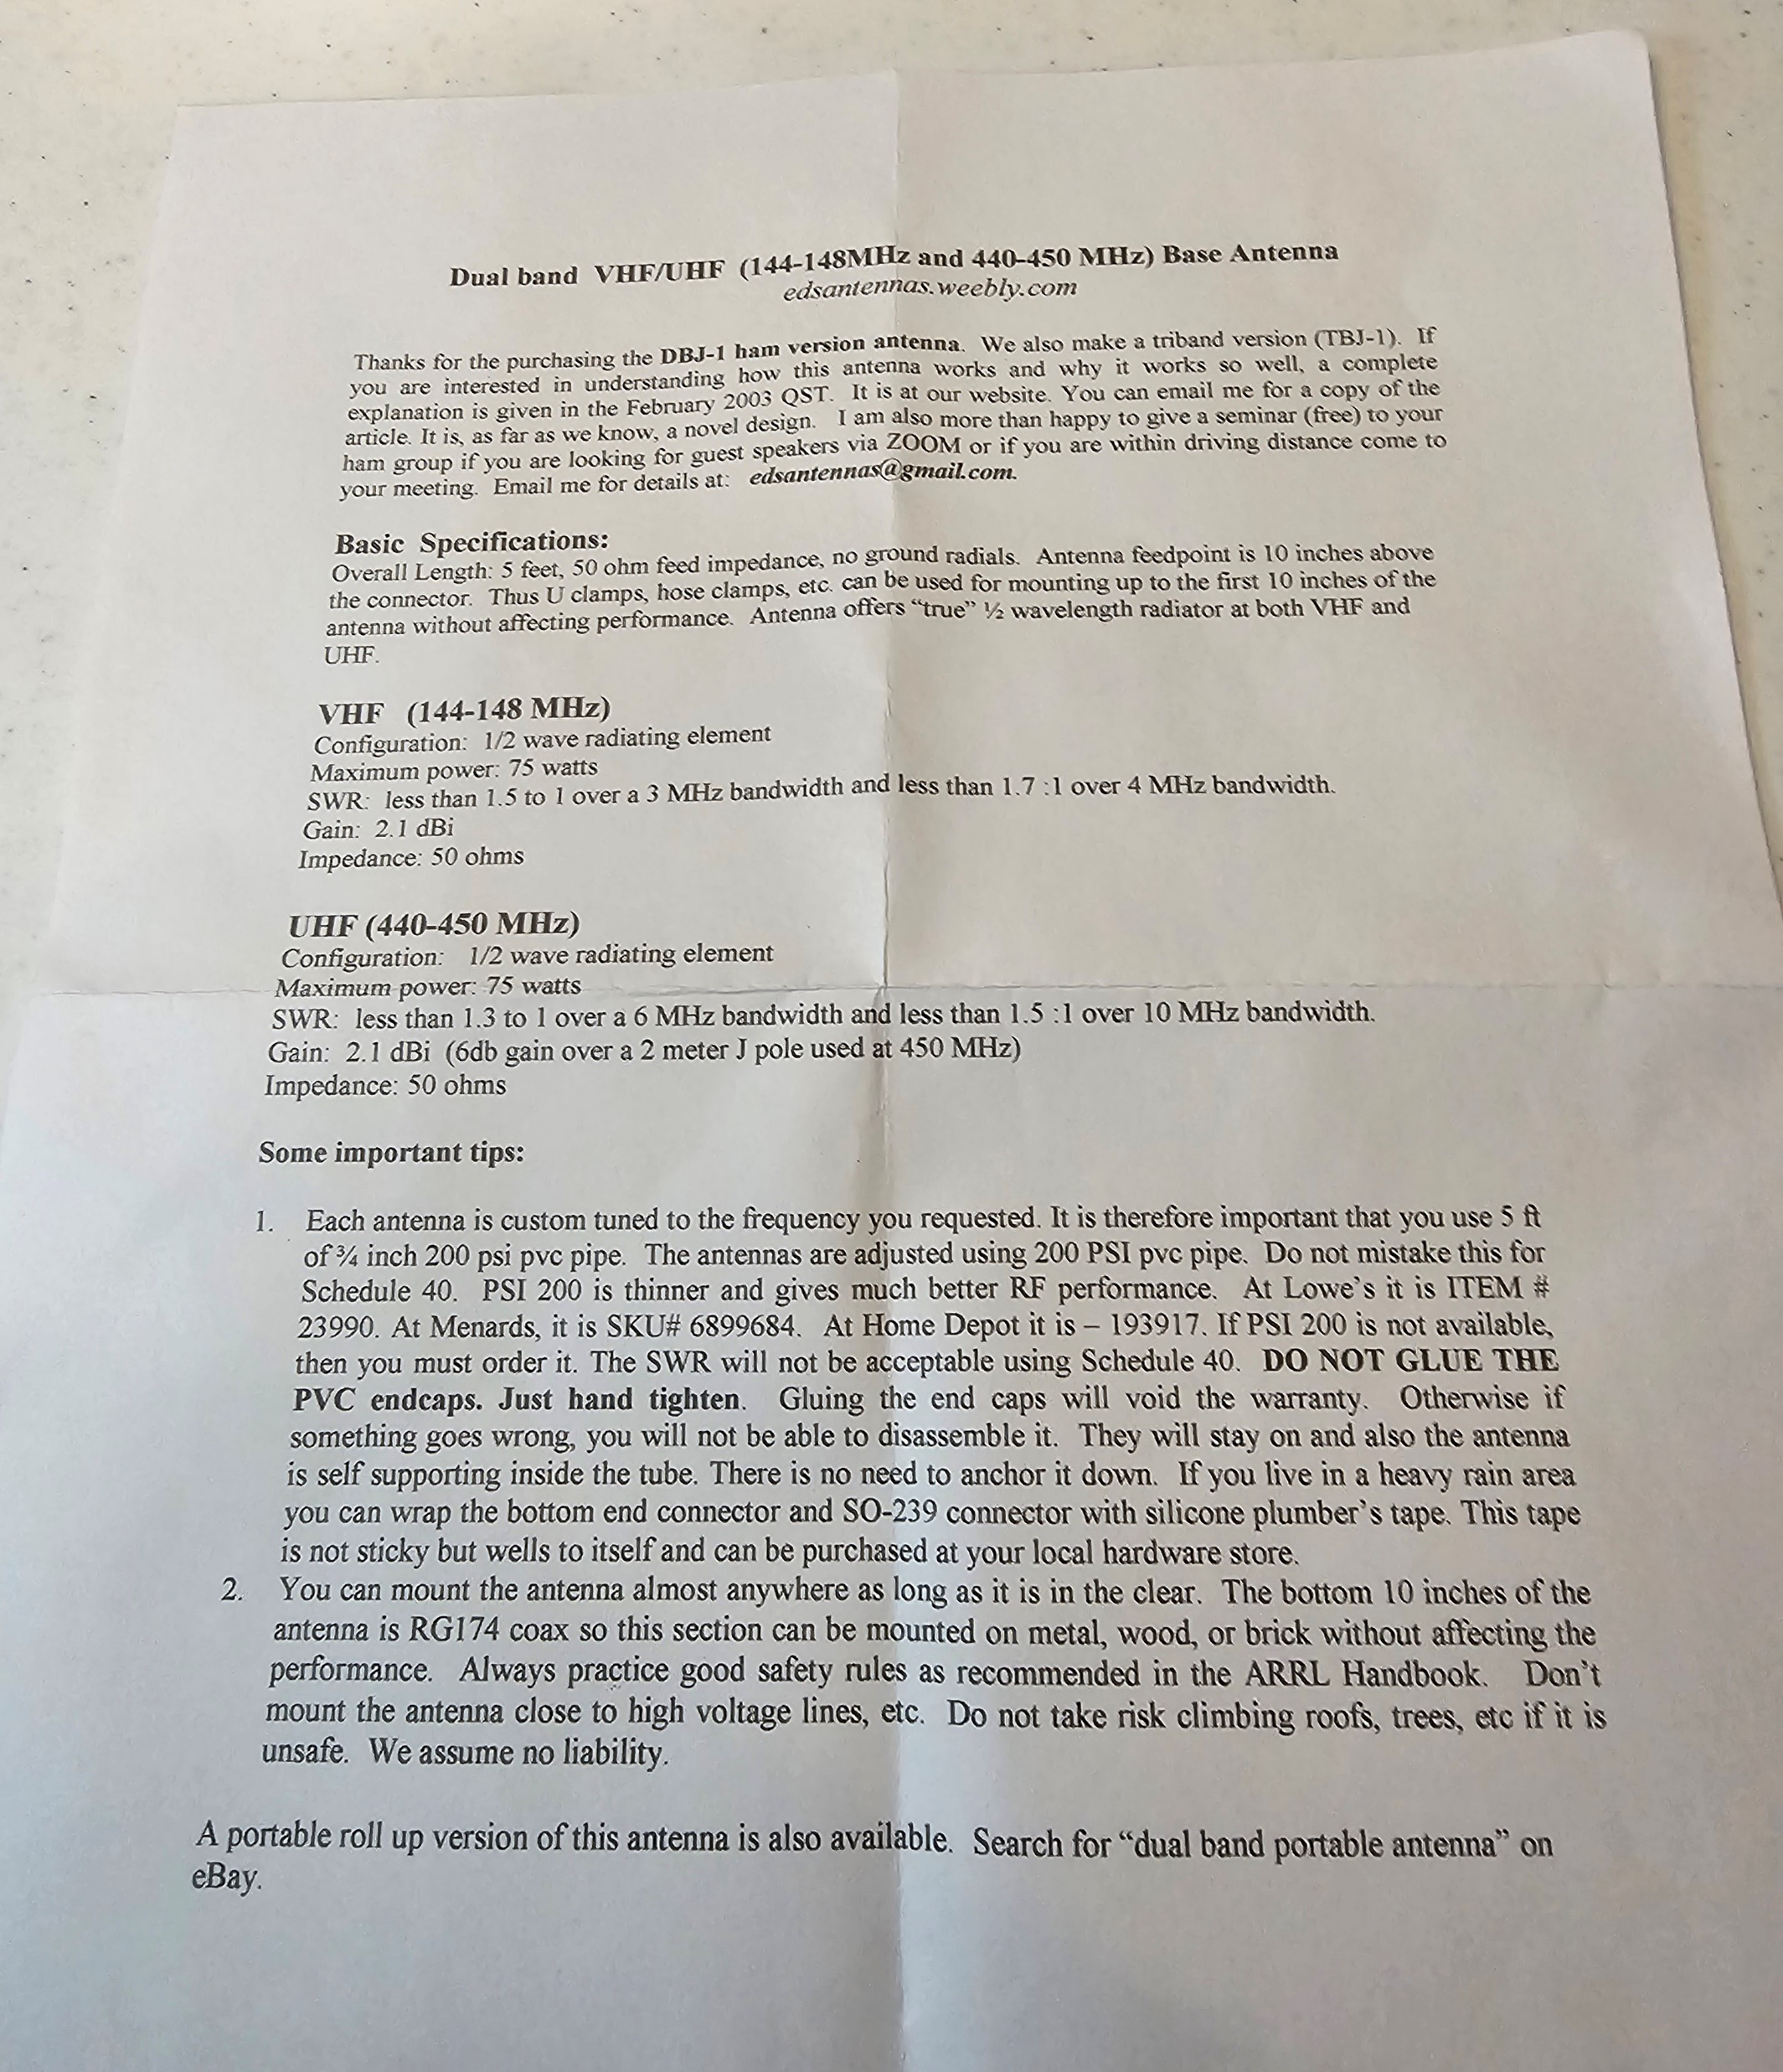
THE BUILD PROCESS
Handy instructions from Dr. Fong:
  Dual Band (2m/70cm):
    Schedule 200.
    Don’t use 40.
  50 Ohm.
  1.1:1 SWR.
  PVC:
    Schedule 200.
    Don’t use 40.
    5-foot long.
  Mounting connection
  on the lower 6”.
  Don’t mount near volage.
12

Slide 13
THE BUILD PROCESS
Inspect the DBJ-1 antenna to assure there are no loose wires or broken solder welds.
Place the DBJ-1 antenna in the PVC tube:
  Note, the PVC is specified as 200 PSI and is 5’.
  Hand fit (never glue) the antenna PVC cap to the end of the PVC tube.
  Hand fit the second PVC cap to the other end.
  Note, once you get home, you may need to remove a cap to feed mounting brackets around the PVC tube.
  Connect any mounting brackets to the lower 6” of the PVC – not higher.
13

Slide 14
THE BUILD PROCESS
If you have an HT, install the PL-259 antenna adapter with a short RG-8X length of cable.
Note, at home a good place to install an in-line SWR meter is between the short RC-8X cable and the longer run to the antenna.
Note, if using your own HT please previously program it to communicate with the HDARC Repeater: 443.750+ PL 100 on Sandia Crest.
Line up to have your antenna measured and tested against the repeater, with our assistance.
Observe the SWR measurement and TX/RX functionality.
14

Slide 15




And without Further Ado
CONGRADULATIONS!
You’re Done.
We’ll Hear You on HDARC 2 Night!
15

